Slide 1
t i d a l t a m u
TETHERED INFORMATICS AND DATA ANALYTICS LAB

Slide 2

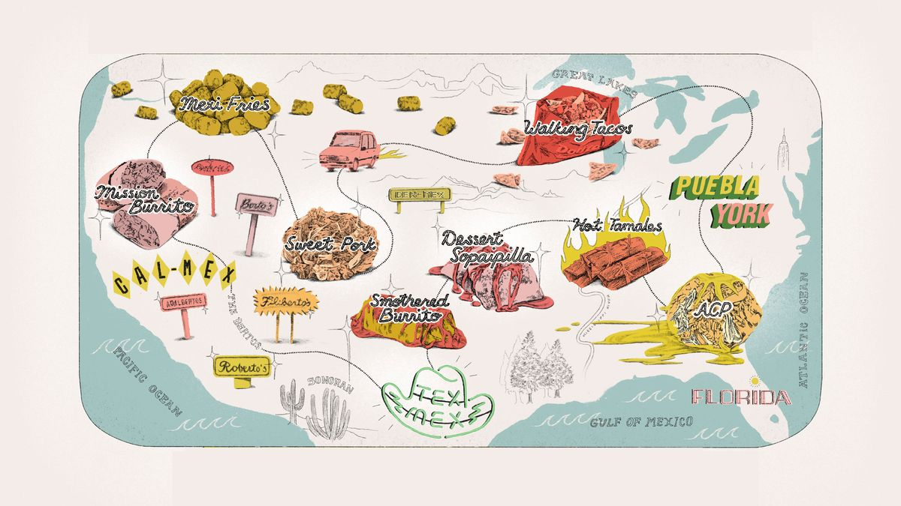
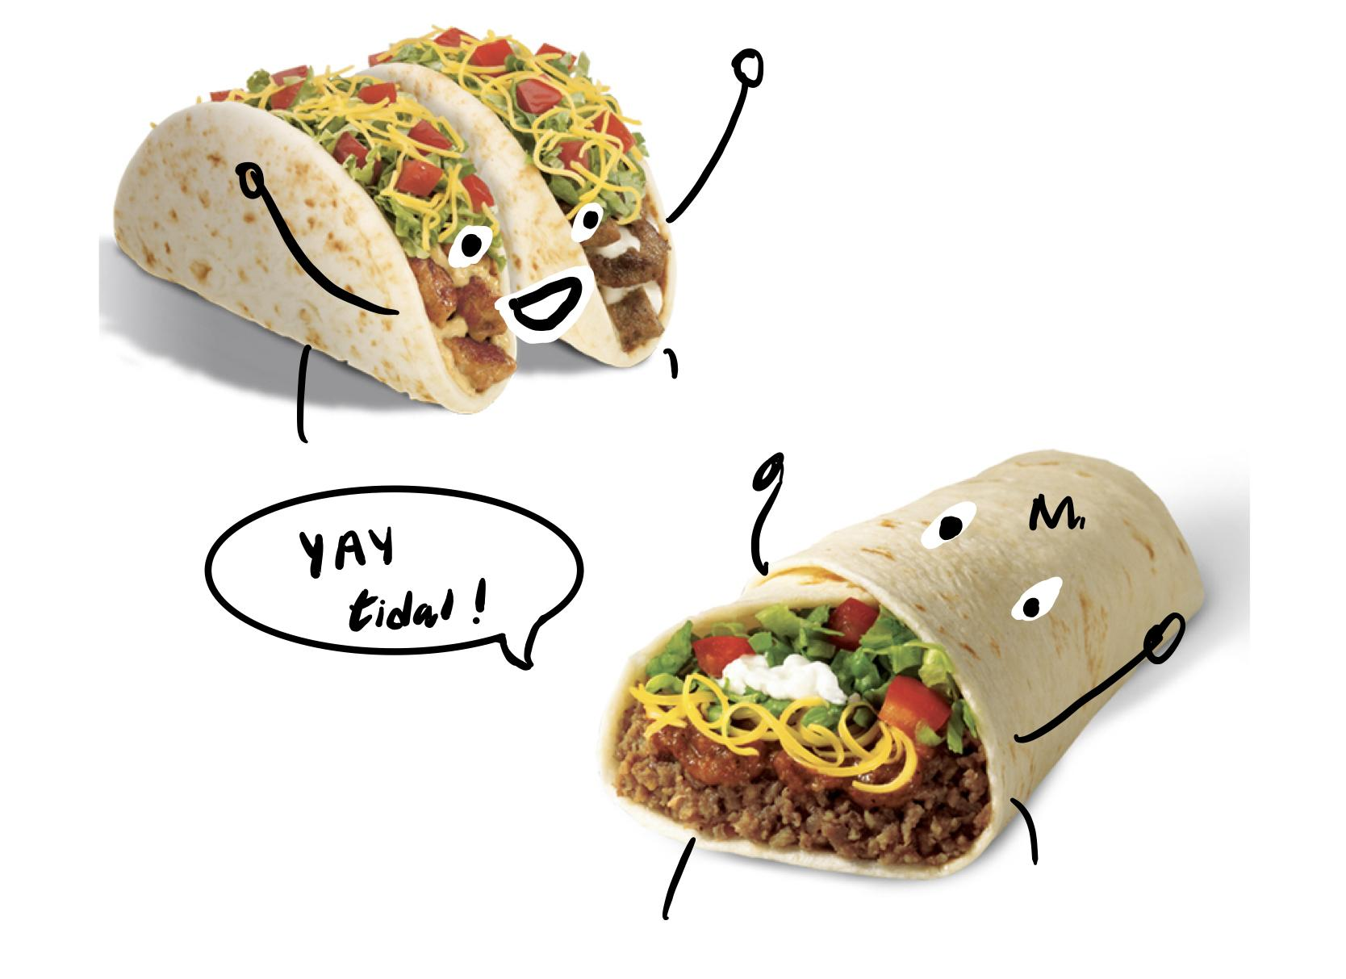
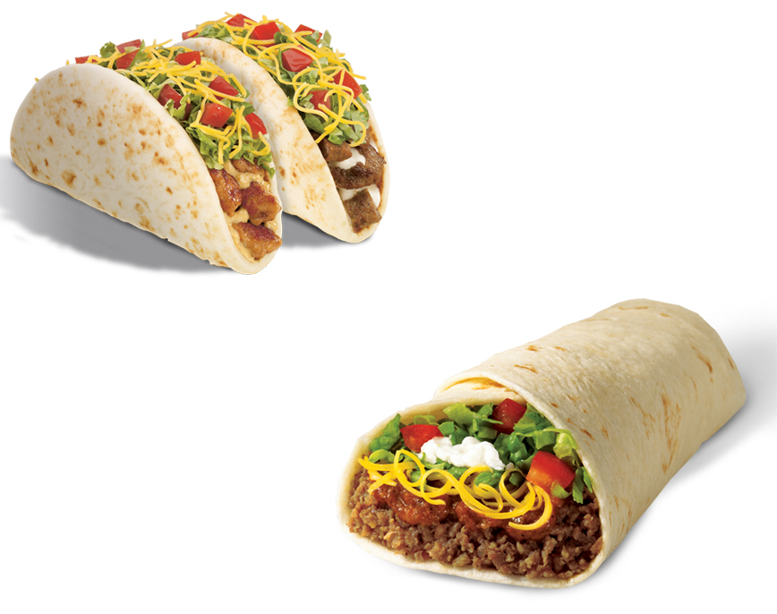
Goldman Sachs: Problem
Design a product to visualize various data on restaurants that sell tacos and burritos in order to understand trends across the united states

Slide 3
Goldman Sachs: Approach
Clean up the data
Acquire additional data via census.gov and factual.com
Population of People per state
Ratio of people to restaurants
Ratio of taco and burrito-serving restaurants to all restaurants in a state
Create a visual to help compare properties and correlations
By Number of Restaurant
By population
Normalized with # of Restaurants

Slide 4
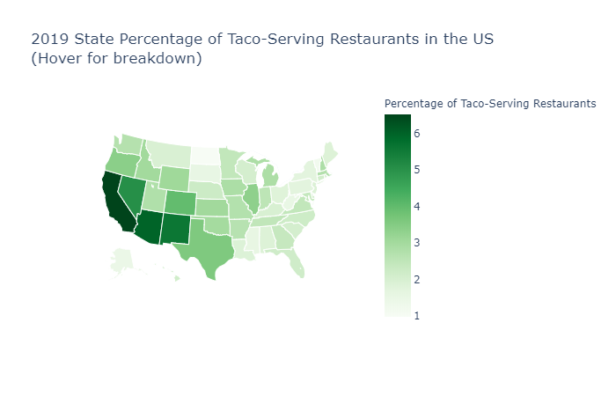
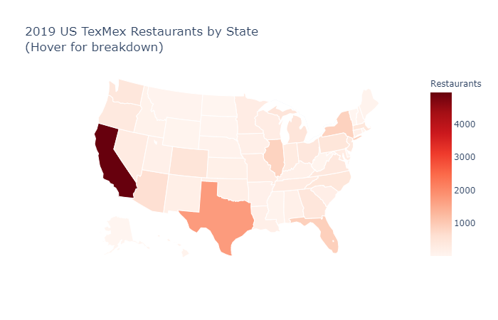
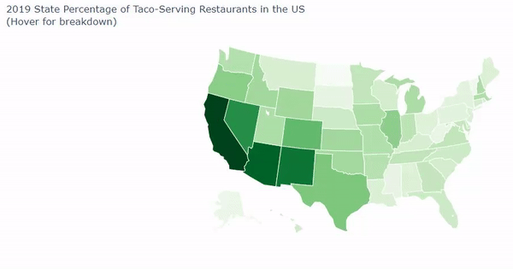
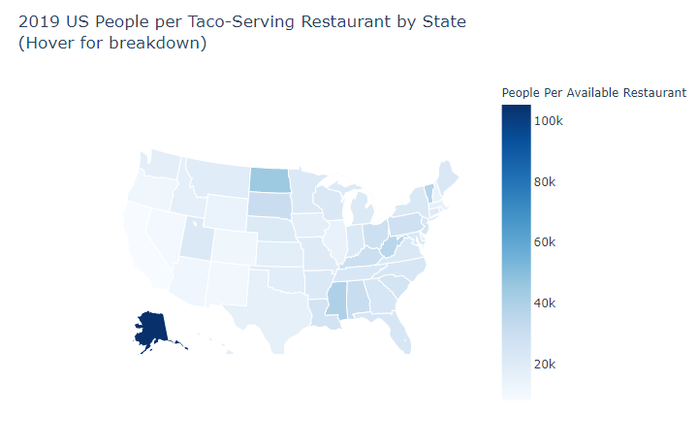
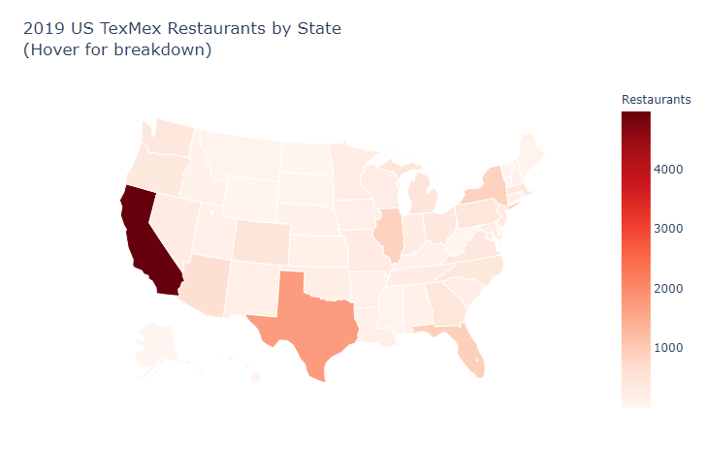
Goldman Sachs: Results
Created a python interactive interface with various filtration.
By Number of Restaurant
By population
Normalized with # of Restaurants

Slide 5
Goldman Sachs: Conclusion
Based on our findings, we now know that:
California and Texas have highest count of places that sell tacos or burritos
Alaska has the most places that sell tacos or burritos per person
The southwestern region has the highest percentage of restaurants that serve tacos and burritos!
If we had more time, we would have:
Gathered more census data to see where the restaurants are in relation to income, household number, etc.
Create a GUI to identify a taco or burrito restaurant to go to based on their own personal preferences by answering questions

Slide 6
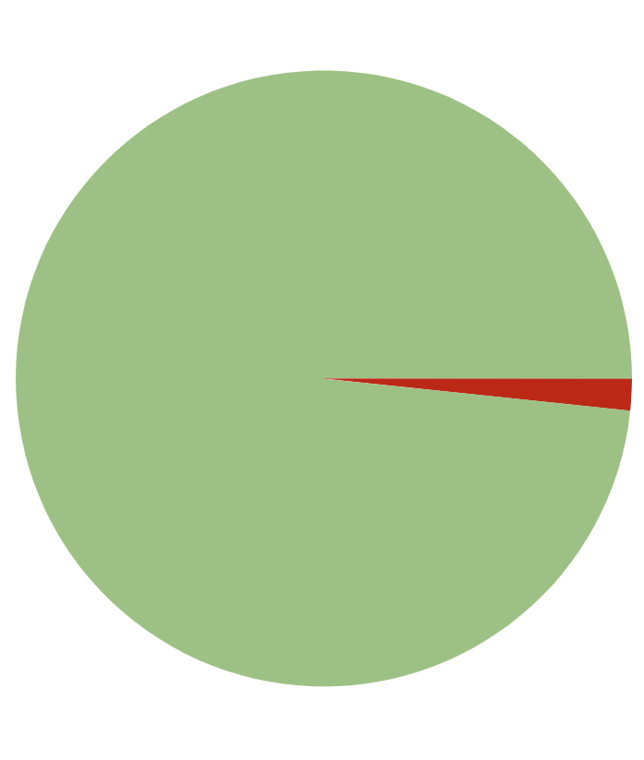
ConocoPhillips: Problem
t
Be able to predict when equipment will fail with the data from 107 sensors (very important for run time)
1000 Failures
59,000 Non-failures
59,000/60,000=.98333
If you guess all zeros, you will still achieve high accuracy score!!!
Sensor Data from ConocoPhillips

Slide 7

ConocoPhillips: Approach
Clean up the data
Identify any correlation in the feature set and visualize (PCA, t-SNE, Pearson Correlation)
Build classifiers (tree based, gaussian, linear)
Identify important features (feature importance, feature extraction and/or engineering)
Predict on the test set (weighted model averages, soft or hard voting, BMA)

Slide 8
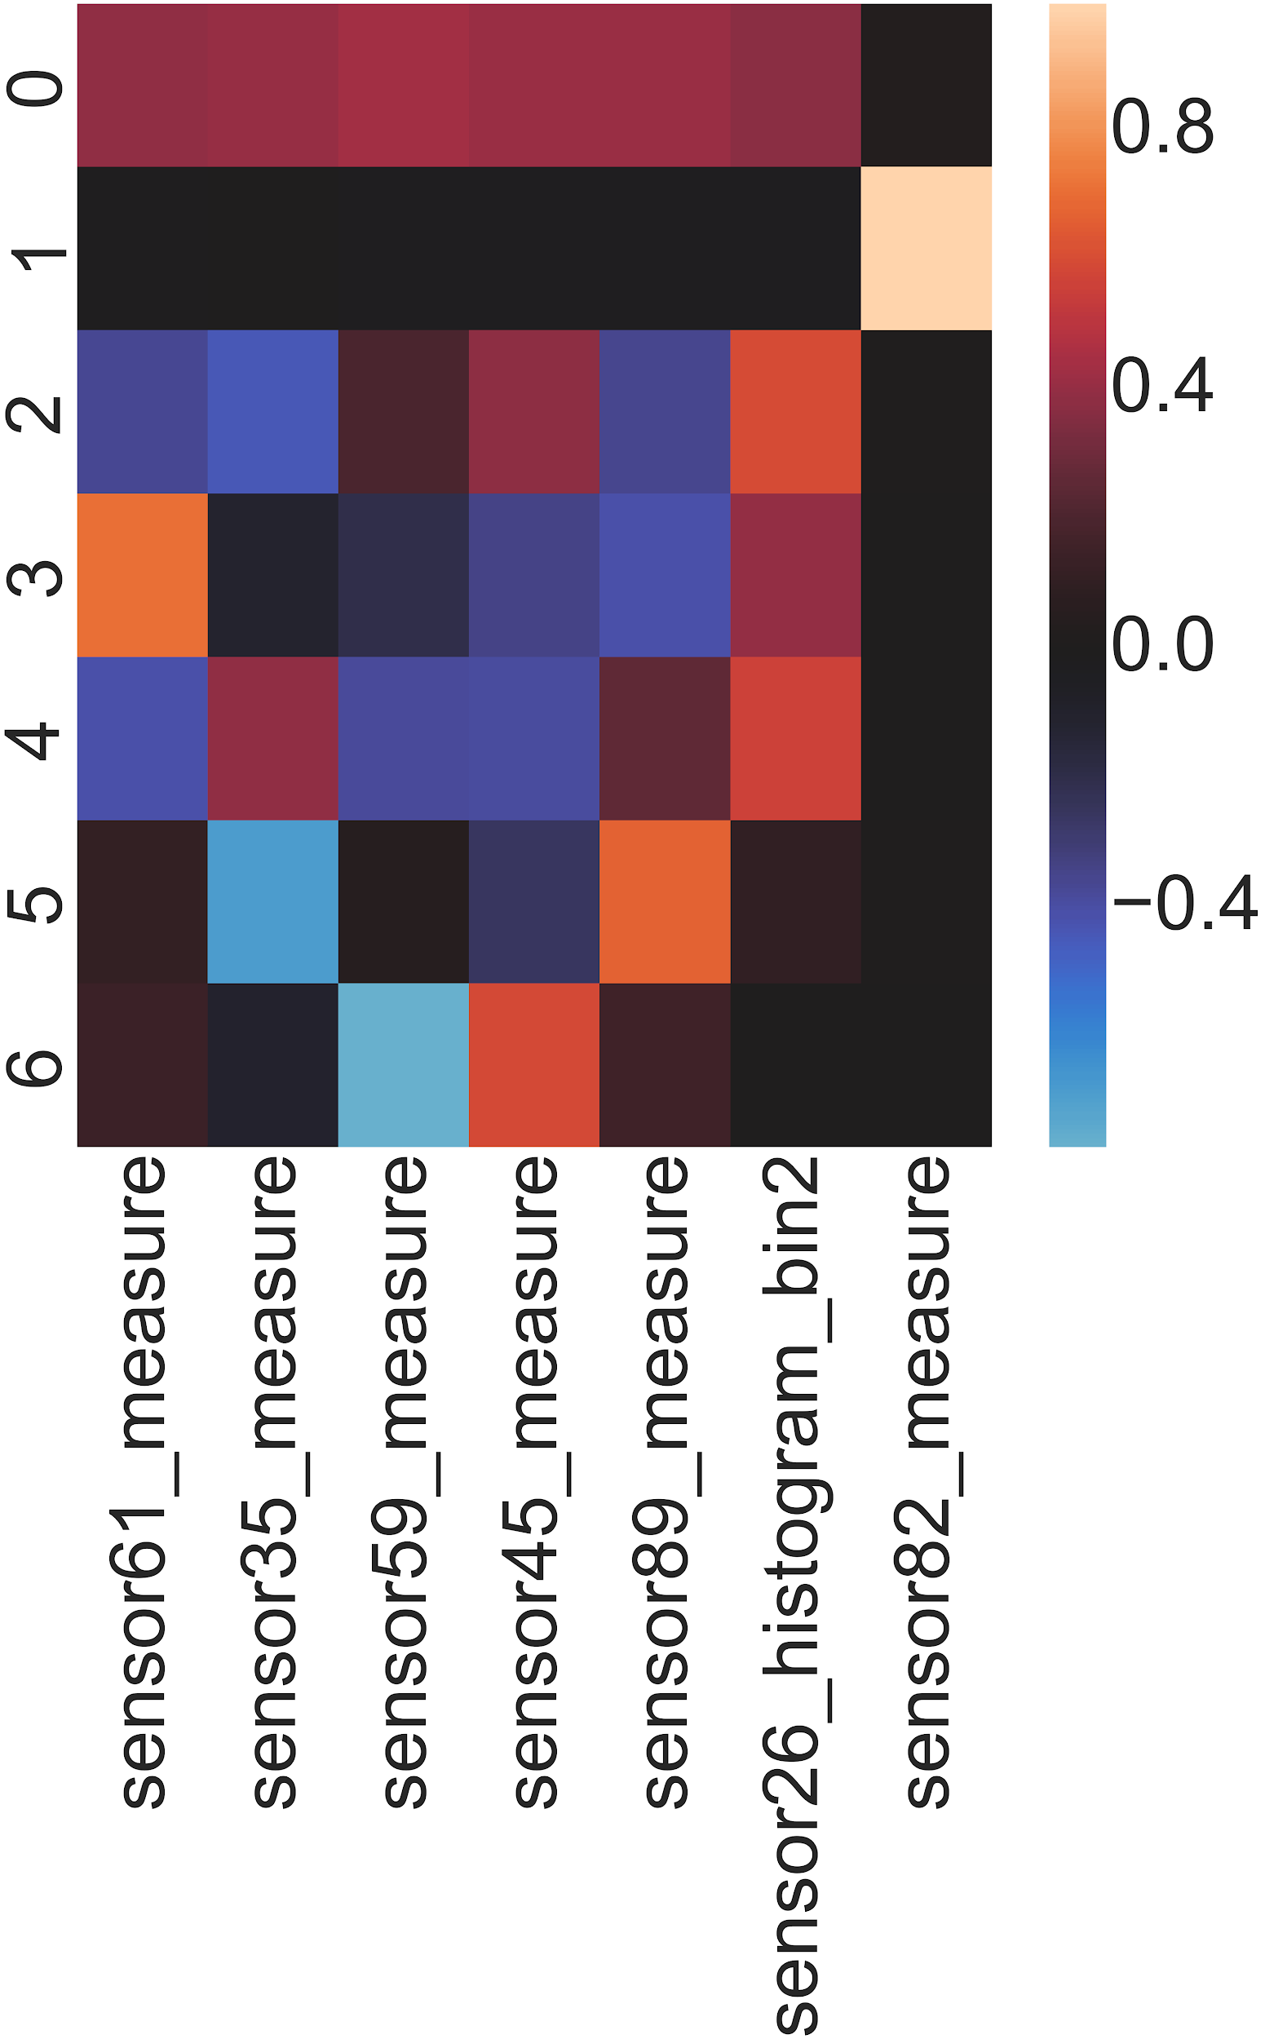
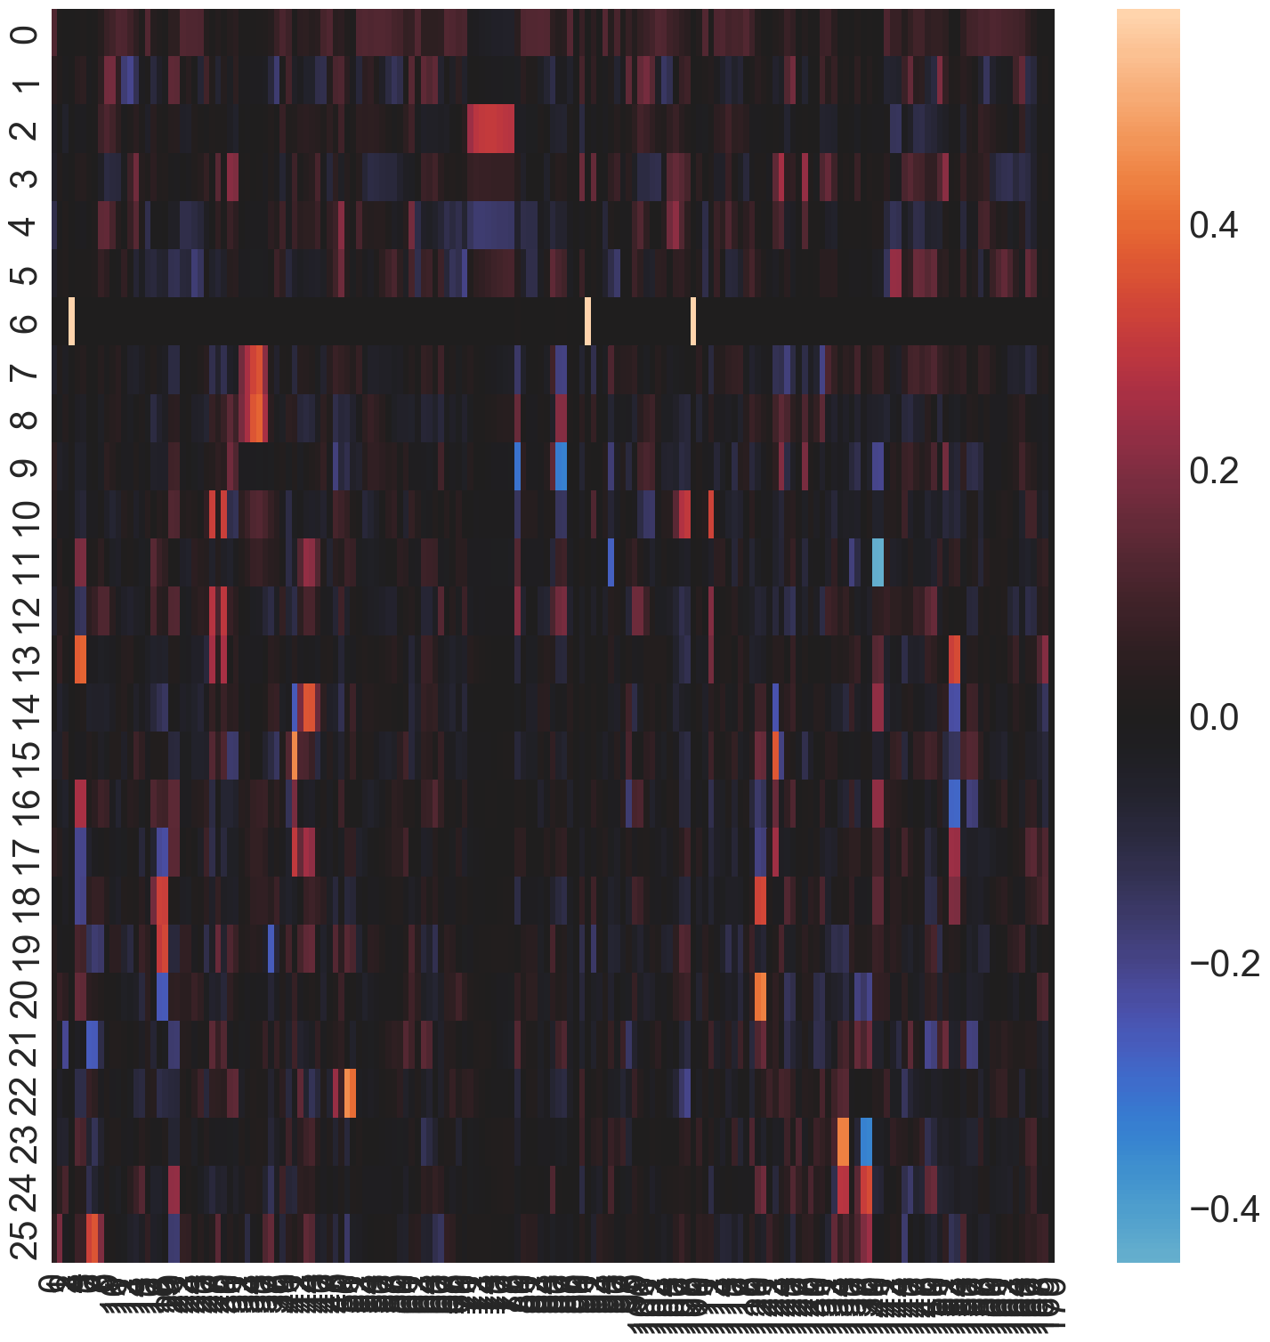
PCA Before Feature Importance
AFTER
Why PCA?
Good to use over t-SNE and Correlation methods in data that is incomplete or has missing data.
BEFORE
PCA: Total Data Set

Slide 9
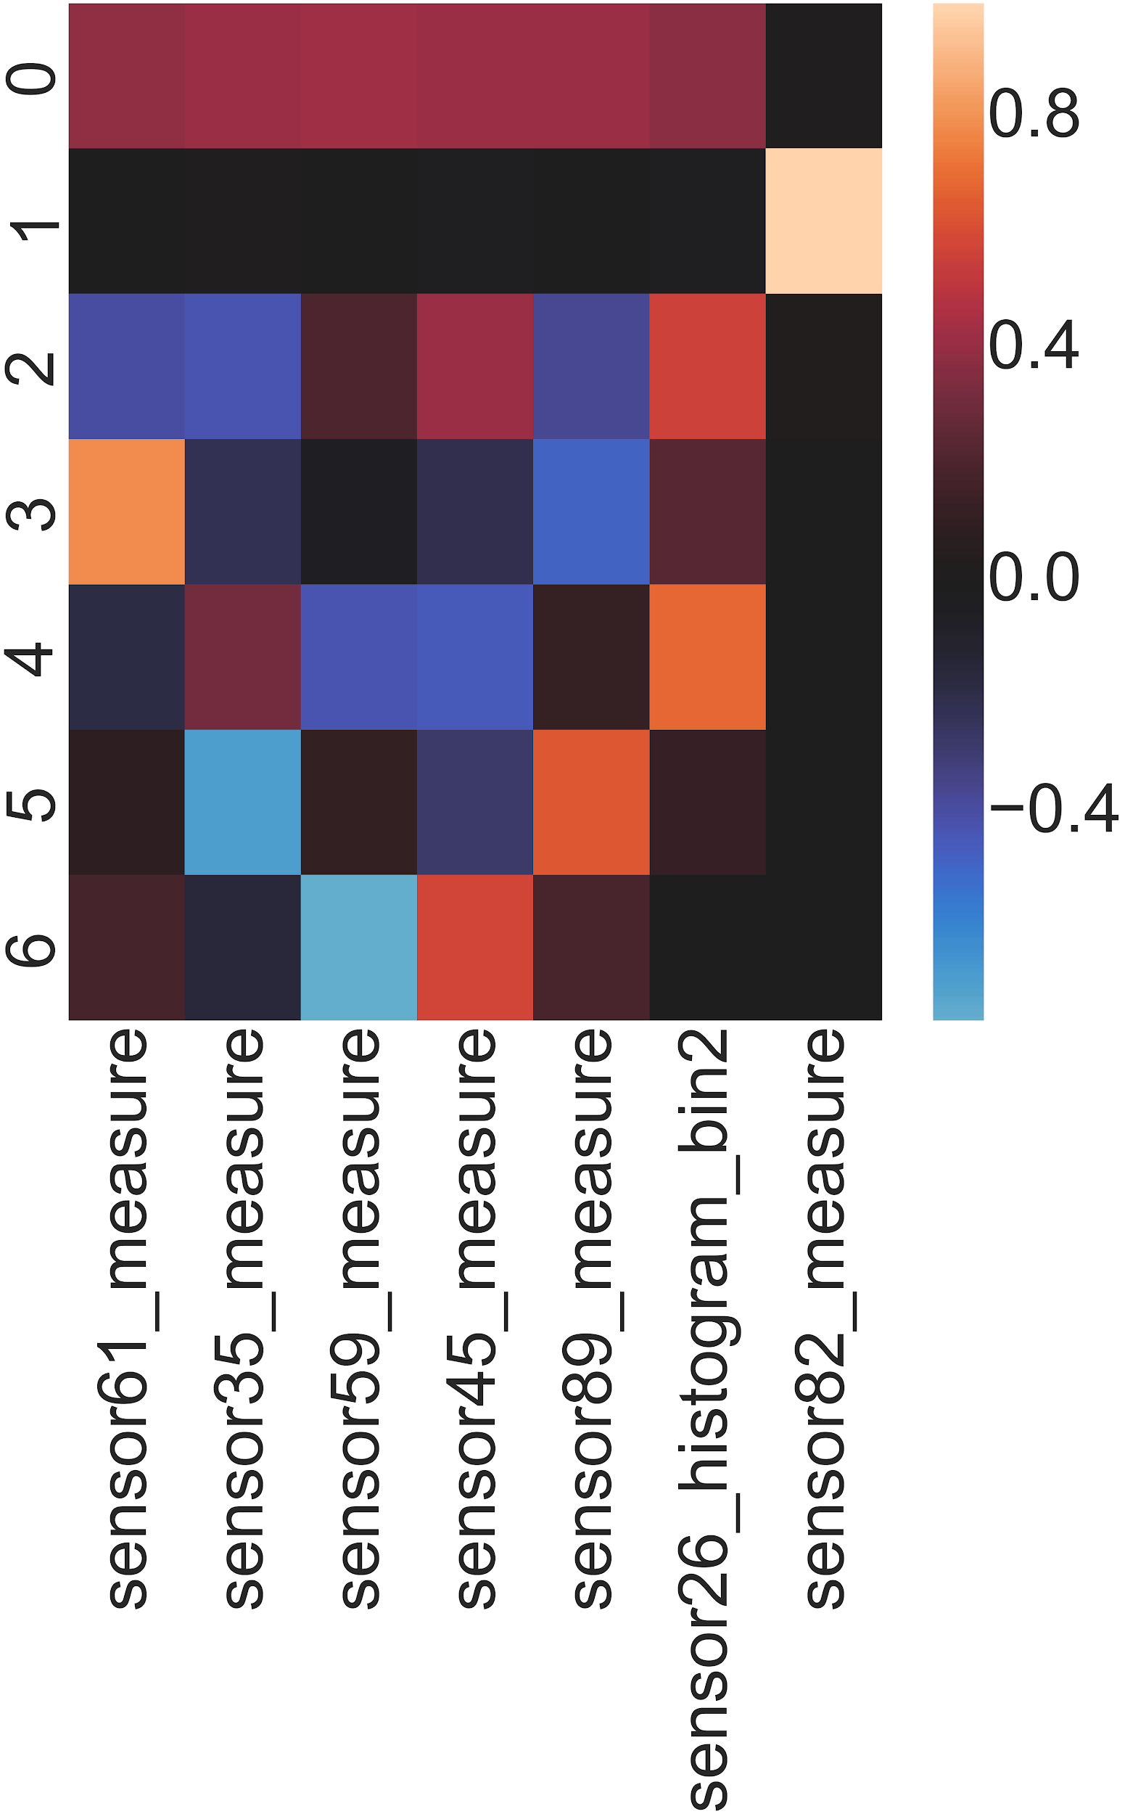
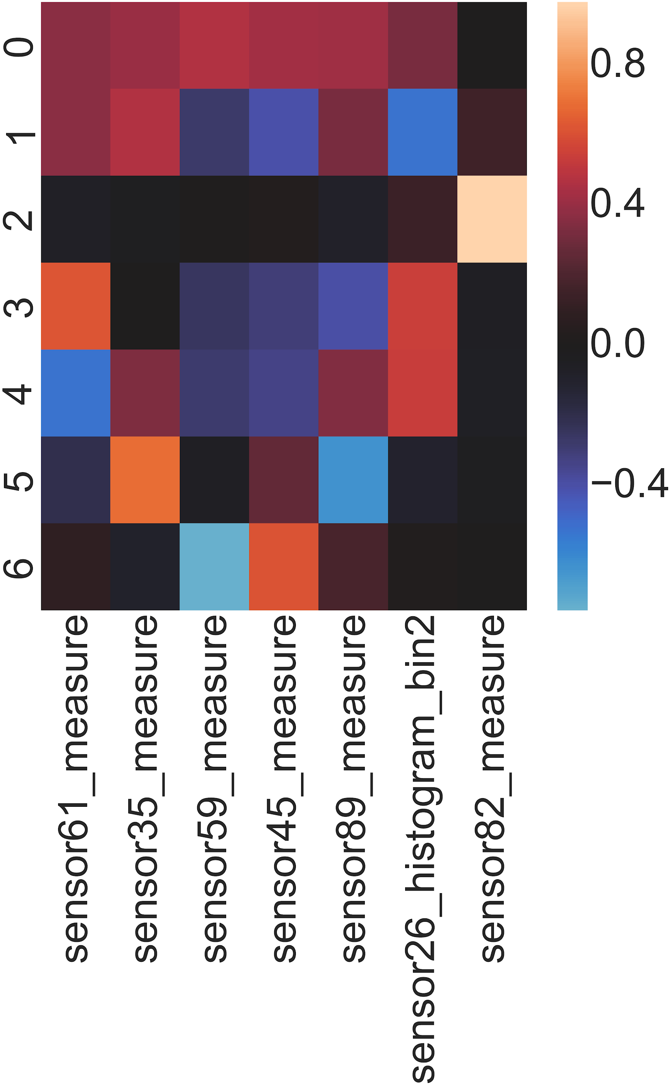
PCA: FI Average
PCA: Successful Data Set
PCA: Failure Data Set
PCA: Total Data Set

Slide 10
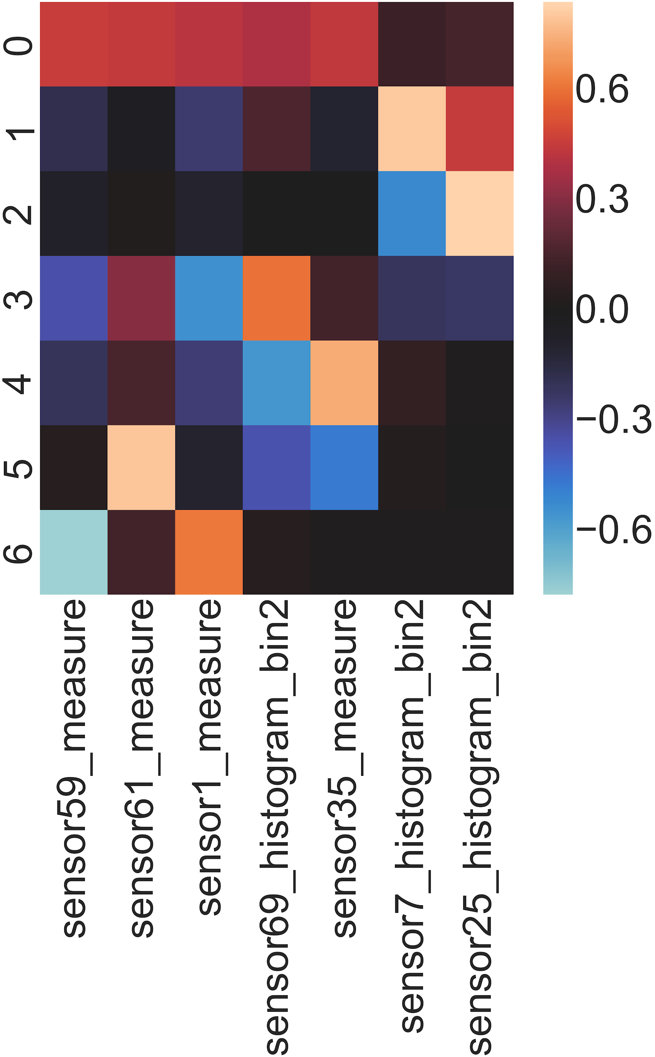
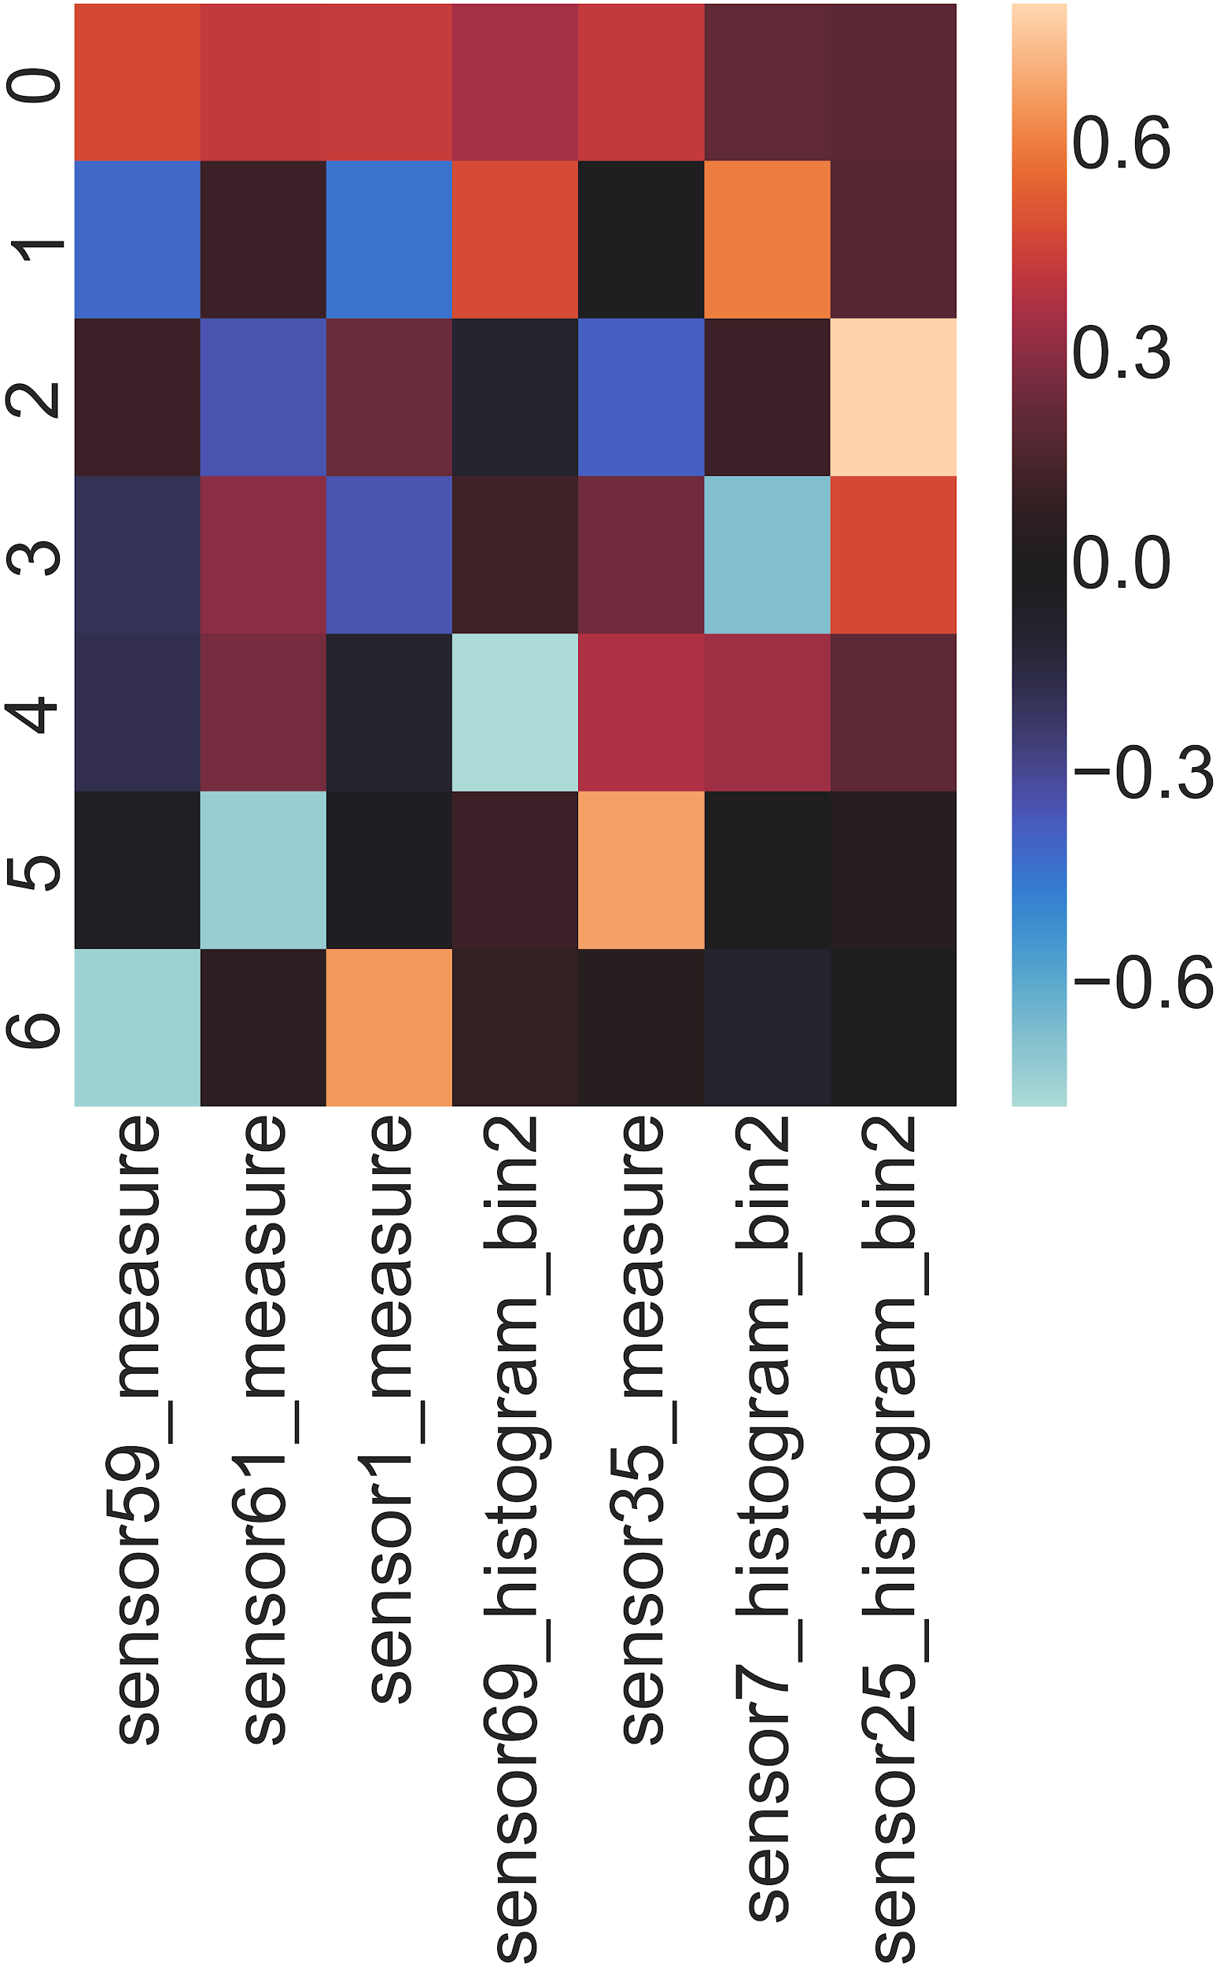
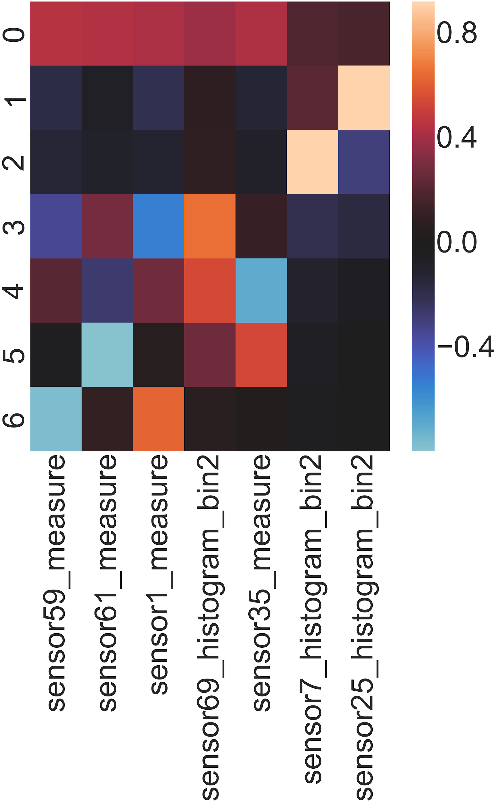
PCA: FI XGboost
PCA: Successful Data Set
PCA: Failure Data Set
PCA: Total Data Set

Slide 11
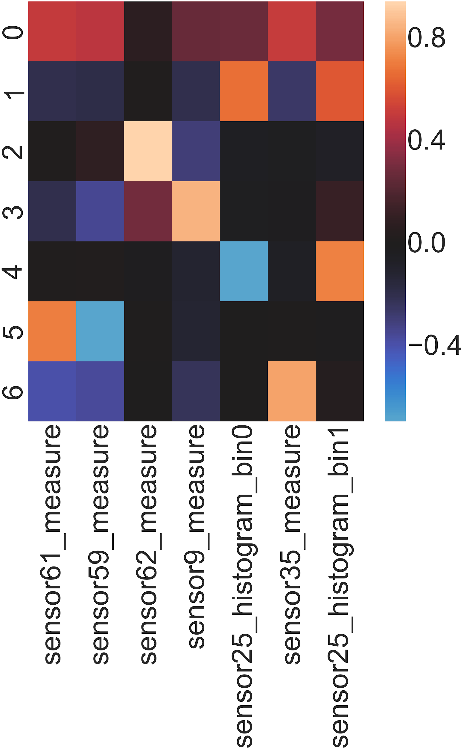
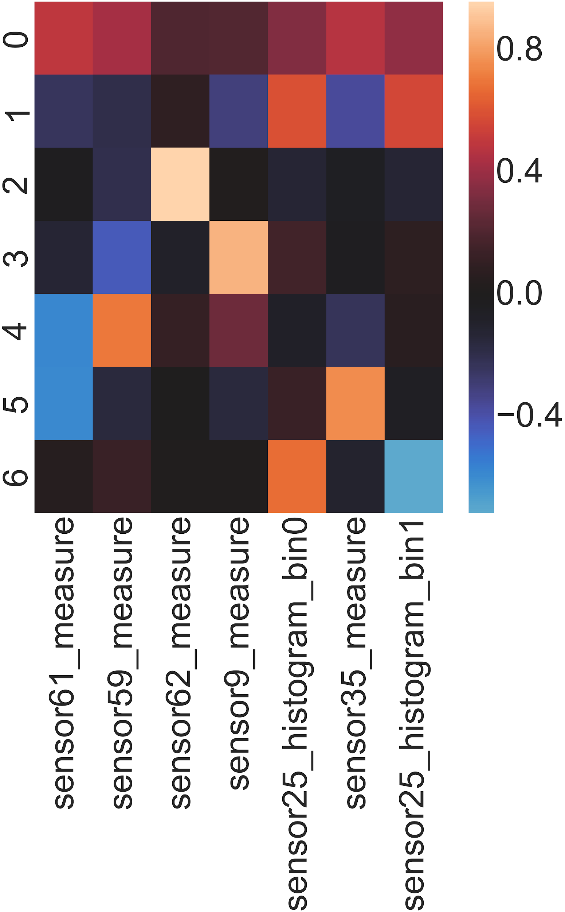
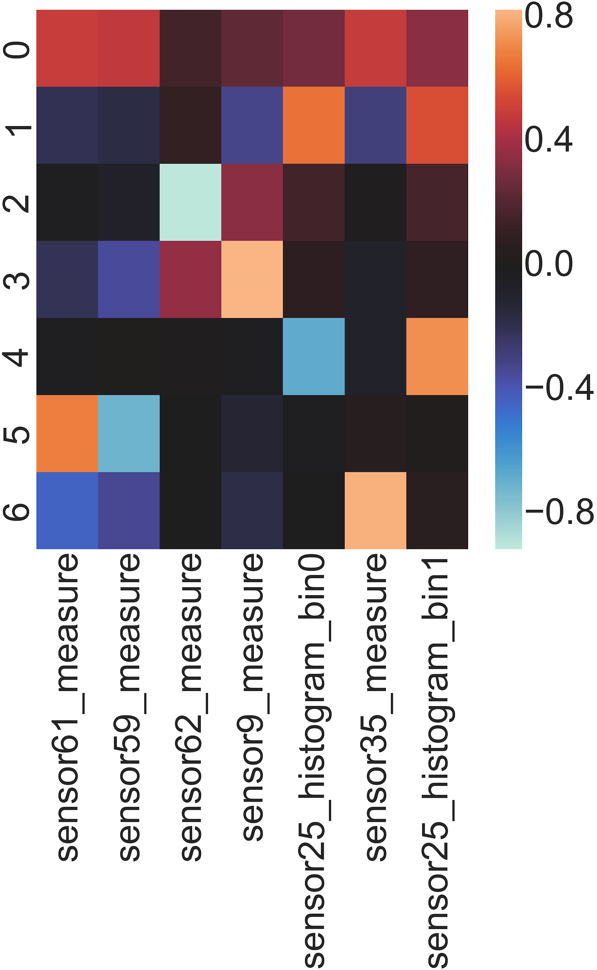
PCA: FI Gradient Boosting
PCA: Successful Data Set
PCA: Failure Data Set
PCA: Total Data Set

Slide 12
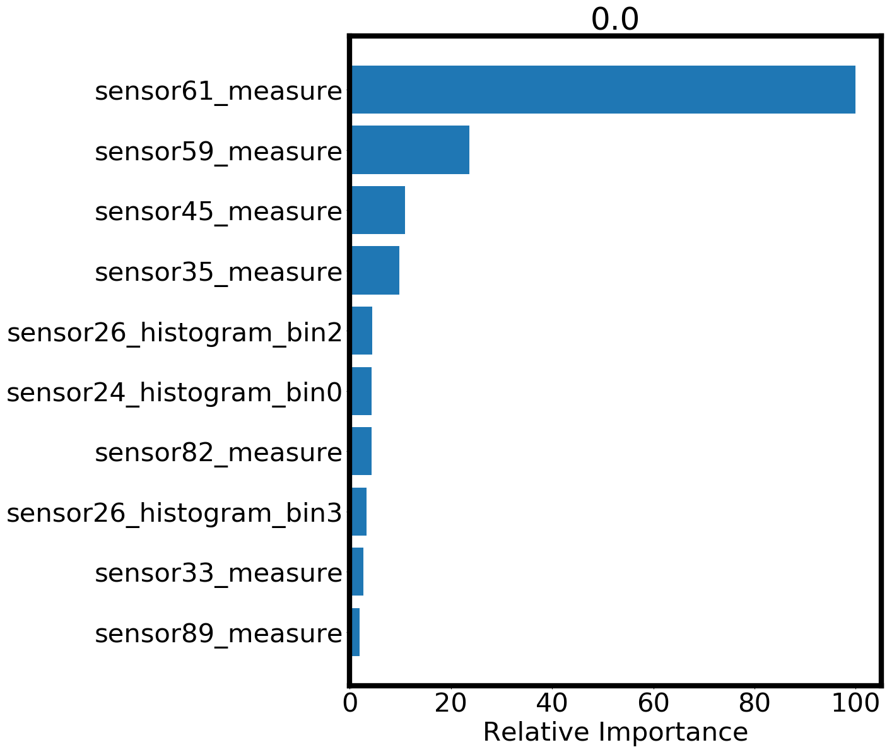
Classification in High Dimension
Why Tree Based?
Tree based algorithms handle higher dimensional and sparse data better than most classifiers like Gaussian, naive, linear, etc
In anomaly detection, tree based classifiers, when tuned correctly, can detect anomaly with good accuracy. Especially tree based algorithms with a built in cost function like gradient boosting

Slide 13
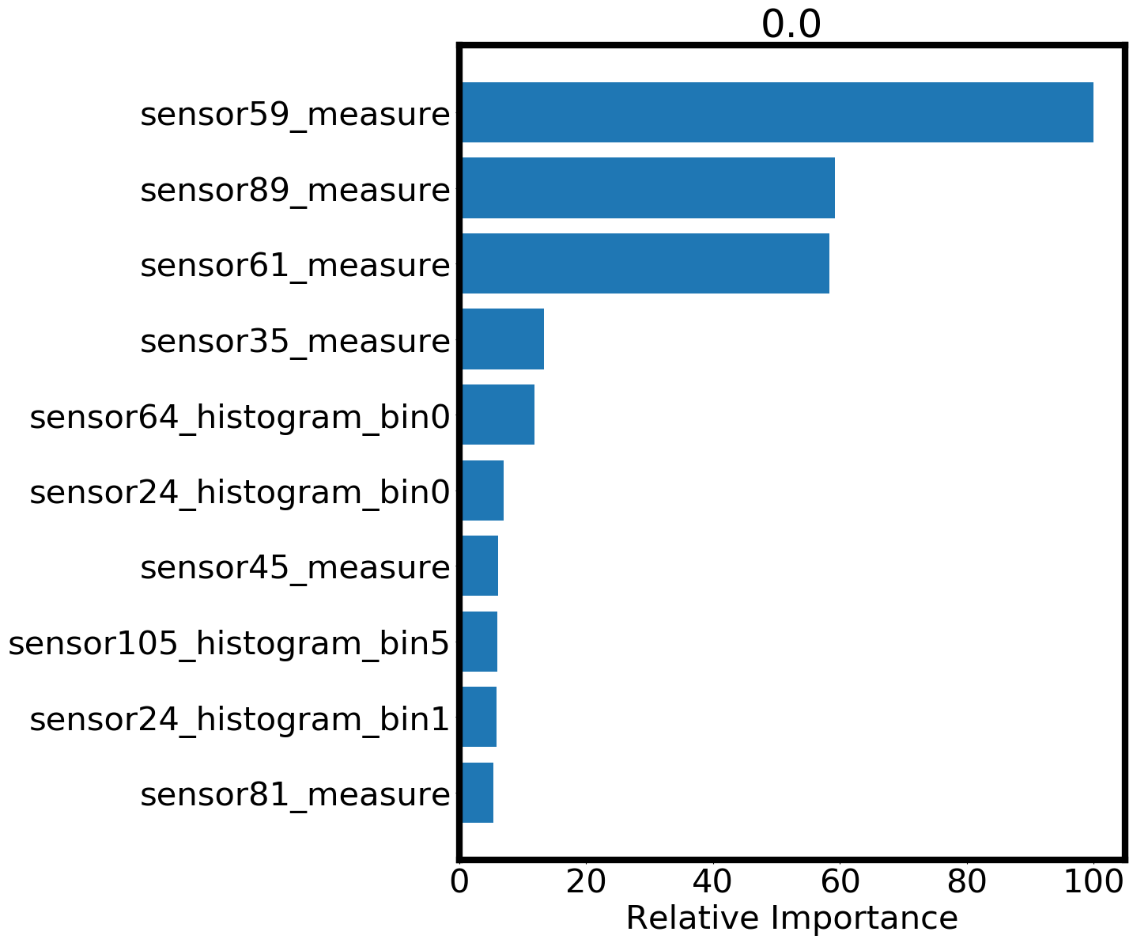
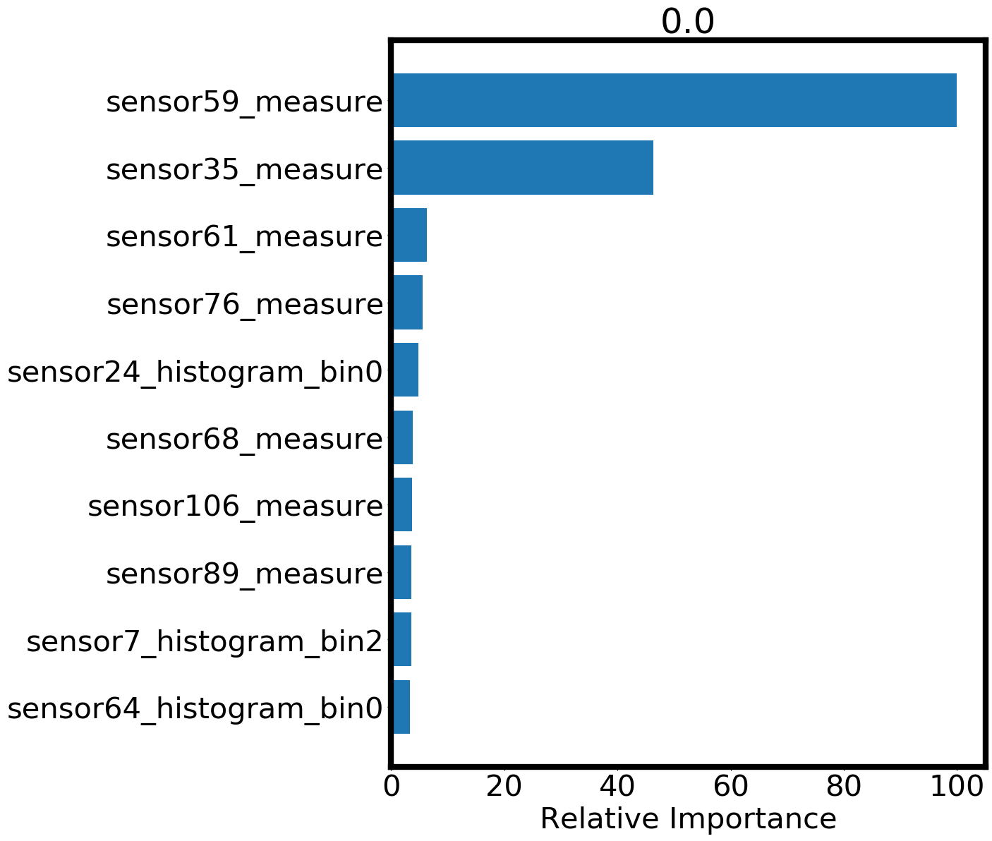
Random Seed: Feature Importance
The data is randomly undersampled, so 1000 data points for target=0 and another 1000 data points for target=1 are used in a classifier.
With each random seed, the important features change.
Notes:
Why is this important?
To help us analyze our data better we want to be able to minimize our scope. Which is my ML is so important

Slide 14
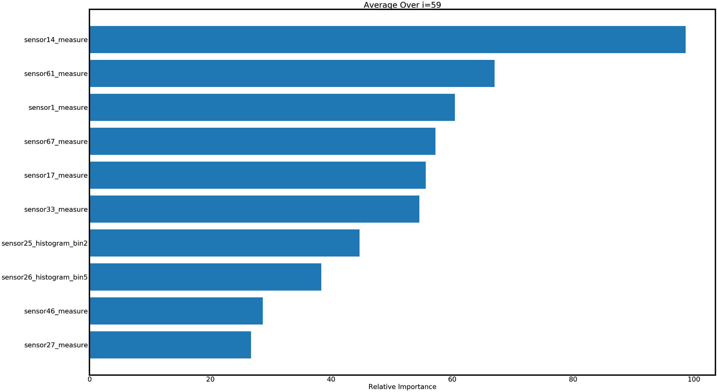
Feature Importance: Random Forest
After 100 iterations, the feature importance and accuracy scores were averaged and reported. These 3 models are later combined by weighting by the scores for predicting targets on the test data set

Slide 15
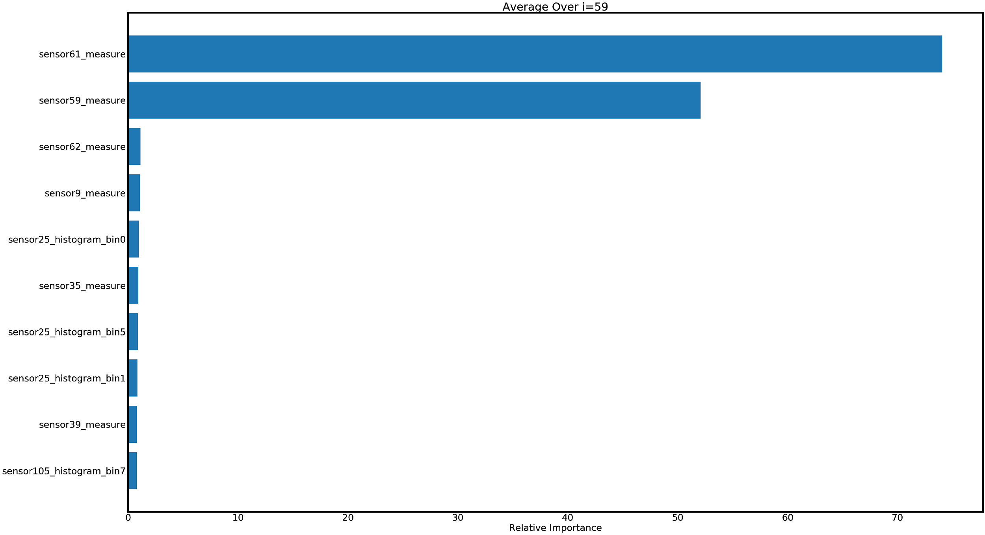
Feature Importance: GBoosting
After 100 iterations, the feature importance and accuracy scores were averaged and reported. These 3 models are later combined by weighting by the scores for predicting targets on the test data set

Slide 16
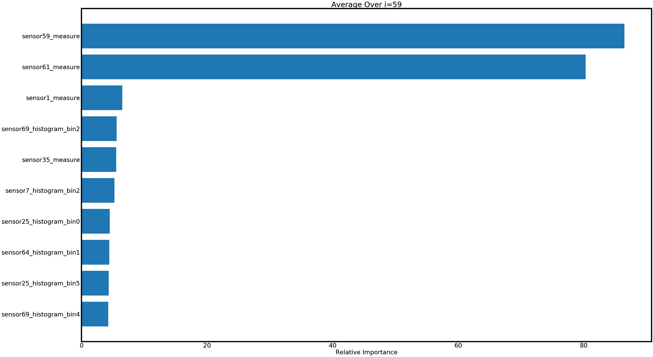
Feature Importance: XGboosting
After 100 iterations, the feature importance and accuracy scores were averaged and reported. These 3 models are later combined by weighting by the scores for predicting targets on the test data set

Slide 17
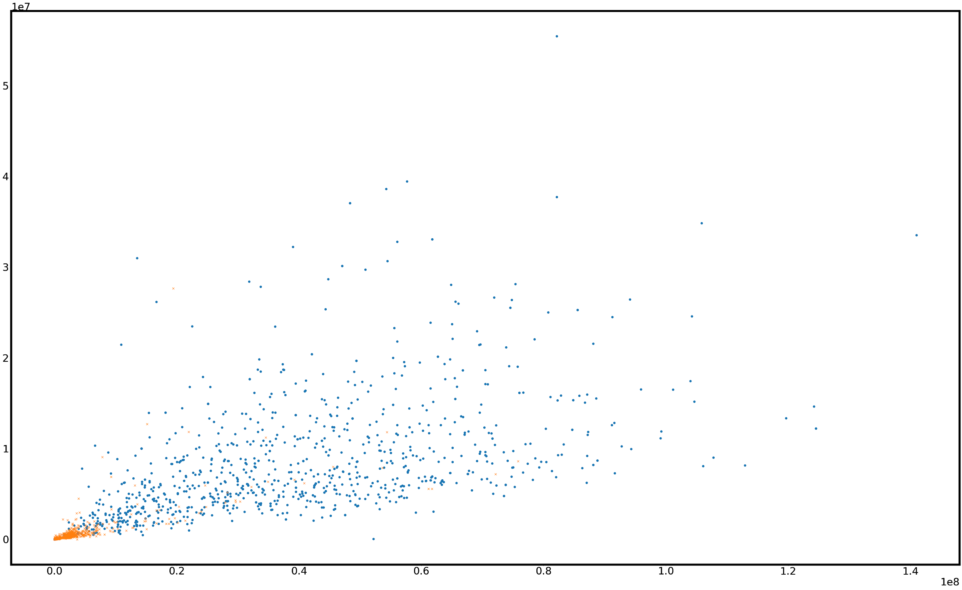
Visualizing Two Naughty Features
The scatter plot shows the data does seem to be somewhat separable by the two most important features from GBoost and XGBoost classifiers.
sensor61_measure
sensor59_measure

Slide 18
ConocoPhillips: Conclusion
Using PCA and feature importance, relative features to detecting the target were identified.
By random undersampling, the classifiers were fit and weighted based on accuracy scores. The voting classifier doesn’t give us full control over the weighting and BMA is unnecessary for models so similar, especially considering tree based classifiers aren’t based on a normal distribution.

